Slide 1
LECTURE 20
Introduction to Swing

Slide 2
COMMONLY USED TERMS
Components:
-All user interface elements that are displayed on the screen and that interact with users are called components.
- Button, labels etc
Containers:
- A container is responsible for laying out any components that is contains.
- Special type of components used to hold other components.
- all swing GUIs will have at least one container.

Slide 3
COMMONLY USED TERMS
Components:
Swing components are derived from Jcomponent class which inherits the AWT classes container and component.
Containers:
1. Top level container like Jframe, Japplet, Jwindows and Jdialogue.
2. Top level container inherits AWT classes container and component.
3. Intermediate container like Jpanel. They inherit Jcomponent.

Slide 4
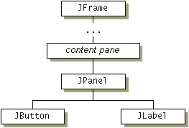
CONTAINMENT HIERARCHIES
To Appear on the screen every GUI component must be part of a containment hierarchy.
A containment hierarchy is a tree of components that has a top-level container as its root.
Containment Hierarchy:
- Top level containers
- Intermediate containers
- Atomic components

Slide 5
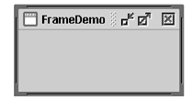

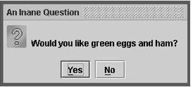
TOP LEVEL CONTAINER
Top level container classes: 1. JFrame 2. JApplet 3. Jdialog 4. JWindows
Frame
Applet
Dialog

Slide 6
FRAME
A window with a title, border and buttons.
Object of JFrame class.
Creating a frame:
JFrame frame = new JFrame(“Test Frame”);

Slide 7
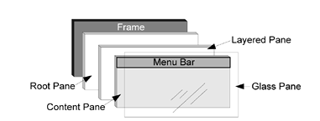
INTERMEDIATE CONTAINERS- PANEL OR PANES
Root panes: Invisibly attached to the top level container and manages everything between components and the top level container.
Root panes:
-the content pane
-the layered pane
-the glass pane

Slide 8
THE CONTENT PANE
Each top-level container has a content pane that generally contains (directly or indirectly) the visible components in that top-level container's GUI.
We find the default content pane of a top level container by using the getContentPane() method.
Content pane is an object of JPanel, a subclass of JComponent.
Creating Content Pane:
JPanel panel = new JPanel();
topLevelContainer.setContentPane(panel); [frame.setContentPane(panel);

Slide 9
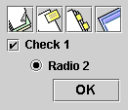
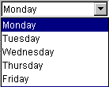





ATOMIC COMPONENTS (1)
Buttons
Combo boxes
Lists
Menus
Sliders
Text Fields
Labels

Slide 10

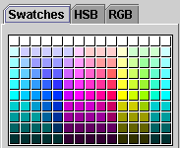

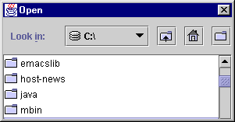
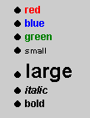
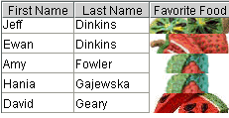

ATOMIC COMPONENTS (2)
Tool tips
Progress bars
Colour choosers
File choosers
Tables
Text
Trees

Slide 11
SWING PROGRAM AND CONTAINMENT HIERARCHY
Each program that uses Swing components has at least one top-level container. This top-level container is the root of a containment hierarchy that contains all of the Swing components that appear inside it.
Other components become child of the top-level container.

Slide 12
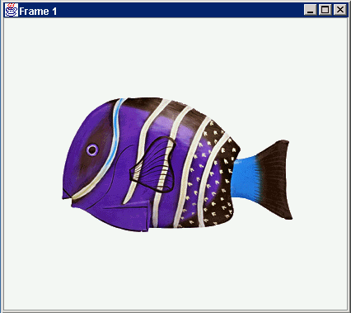
ANATOMY OF AN APPLICATION GUI
GUI
Internal structure
JFrame
JFrame
JPanel
containers
JPanel
JButton
JButton
JLabel
JLabel

Slide 13
USING A GUI COMPONENT
Create it
Configure it
Add children (if container)
Add to parent (if not JFrame)
Listen to it
order
important

Slide 14
BUILD FROM BOTTOM UP
Listener
Create:
    Frame
    Panel
    Components
    Listeners
Add: (bottom up)
    listeners into components
    components into panel
    panel into frame
JLabel
JButton
JPanel
JFrame

Slide 15
FIRST PROGRAM USING SWING
import java.awt.Container;
import javax.swing.JLabel;
import javax.swing.JFrame;
class HelloWorld extends JFrame
{
public HelloWorld()
{
setTitle("Hello World");
Container contents=getContentPane();
contents.add(new JLabel("Hello World!"));
setDefaultCloseOperation(EXIT_ON_CLOSE);
pack();
}
}
public class test_swing
{
public static void main(String args[])
{
HelloWorld test=new HelloWorld();
test.setVisible(true);
}
}

Slide 16

OUTPUT

